Slide 1
CS 4530: Fundamentals of Software Engineering Module 4: Web Applications
Adeel Bhutta, Rob Simmons, and Mitch Wand
Khoury College of Computer Sciences
© 2026 Released under the CC BY-SA license

Slide 2
Learning Goals for this Lesson
At the end of this lesson, you should be able to
Explain the role of “client” and “server” in the context of web application programming
Explain the role of HTTP endpoints and REST APIs versus WebSocket communication and event-driven messaging in a web application
Describe the fundamental differences between the three layers of the controller, service, and repository layers in a C-S-R architecture
Understand how the C-S-R architecture works in the context of a basic Express application
Be able to answer an interview question about “business logic,” “horizontal and vertical scaling,” or “microservices”

Slide 3






So, software engineering must encompass:
PEOPLE
PROCESSES
PROGRAMS
PLANNING
We’re gonna be stuck over here for a bit.
ORGANIZING
implementing
Notes:
So far in this class, every lecture has been about organizing people, processes, and programs in some way: when we talk about testing or typescript, we saw a lot of code but discussed how contracts and tests are communicating with the future (people) and how code coverage metrics lets us quantitively assess our progress (processes).
In the next few lectures, we’re going to be “stuck” over on the right a little bit, focusing more on some programming knowledge you’ll need as you move past IP1 to the other individual projects and the big group project.
Almost every class in software engineering needs to do this, because you can’t learn software engineering without doing some programming in the context of a large software project. The next few lectures are about how our particular variety of large software project works: a web application. What’s a web app?

Slide 4
Web Applications are Distributed Systems
Distributed systems are applications that perform computation across different computers
Web applications are distributed systems because
Users are literally in different places: you don’t live in a data center
Netflix won’t fit entirely on one computer
Distributed systems are hard!
Adopting well-understood patterns makes the task easier
We’ll talk about one kind of pattern in this lecture
If you’re Google, Netflix, or Amazon, the simple designs in this lecture won’t serve your purposes
Notes:
A web application is a relatively simple and extremely common example of a distributed system.
This is necessary given the goals of our website, and most websites: GameNite wants to help people play a game if they’re not in the same place, so they’re distributed. Websites also need to be distributed for scalability, which we’ll talk about, but only a bit.
Q: Why can’t Netflix be run off of one computer?
(A: It would be really slow — Netflix has to respond to too many clients to do so with one CPU — and it would have too much data for one computer to handle. And probably also rights management.)

Slide 5
An Insultingly Shallow Intro to Networking
SERVER
(a program running on a computer in a data center somewhere)
CLIENT
(a web browser running in a consumer operating system on a consumer device)
internet
Notes:
This lecture is trying to cover material you could spend a semester learning in:
CS 3700 Networks and Distributed Systems
CS 4550 Web Development
CS 4730 Distributed Systems
CS 6650 Building Scalable Distributed Systems
Suffice to say this is an overview: a server (in a data center) is trying to communicate with a client (a web browser on your laptop) over the internet. How does that work?

Slide 6
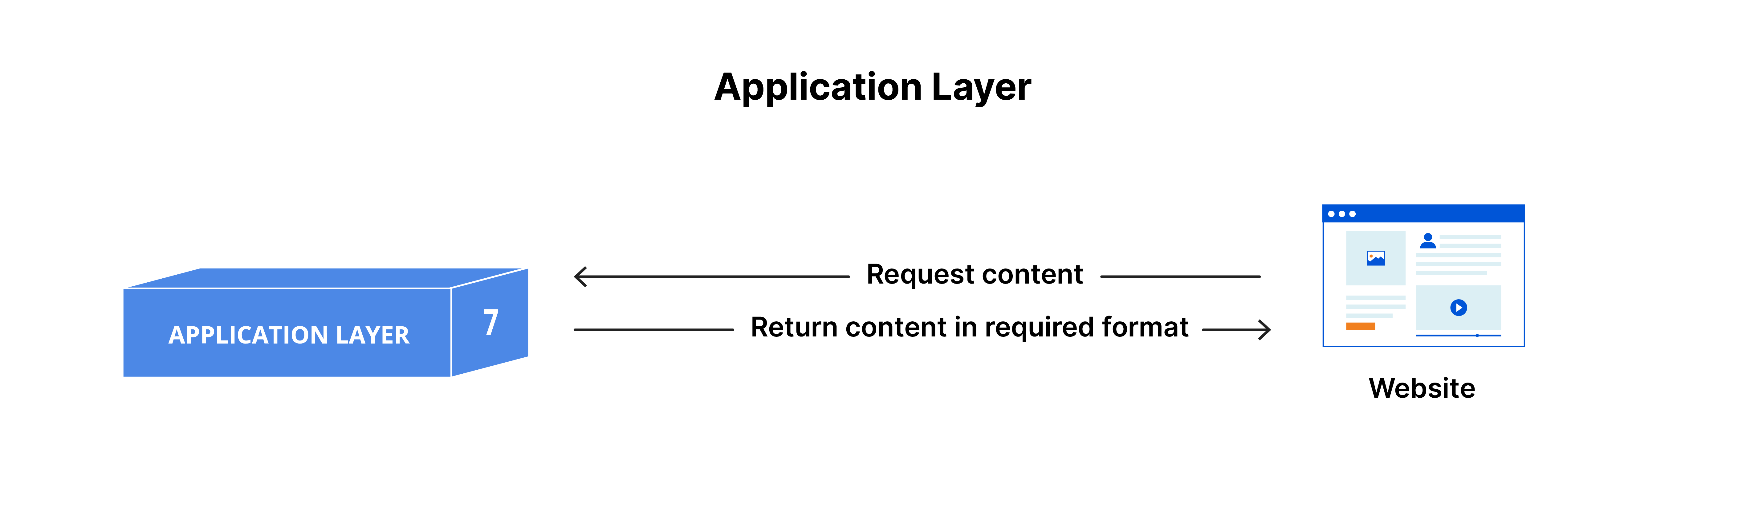
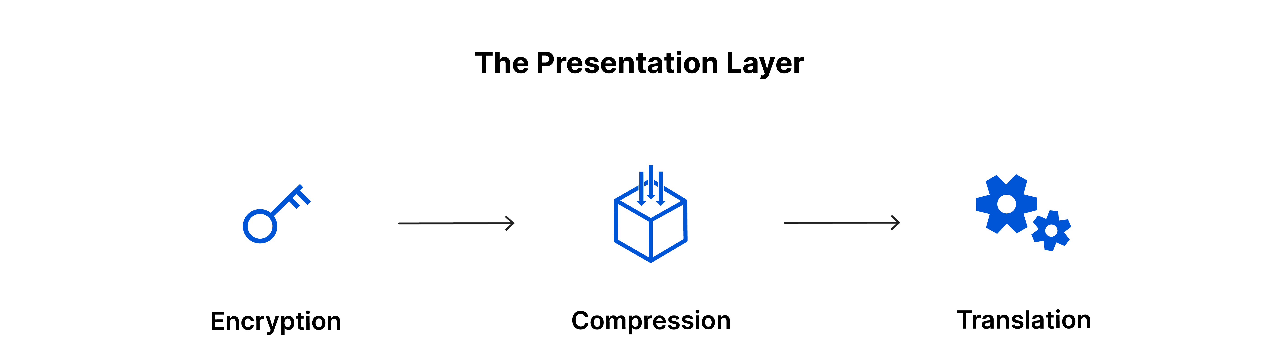

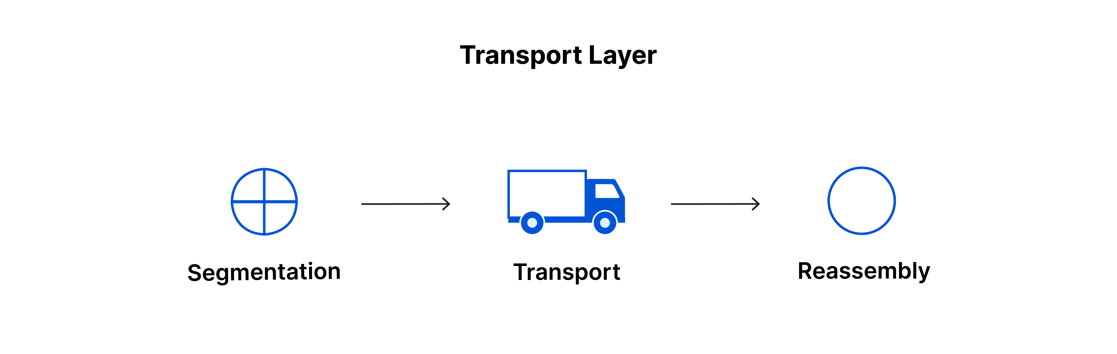
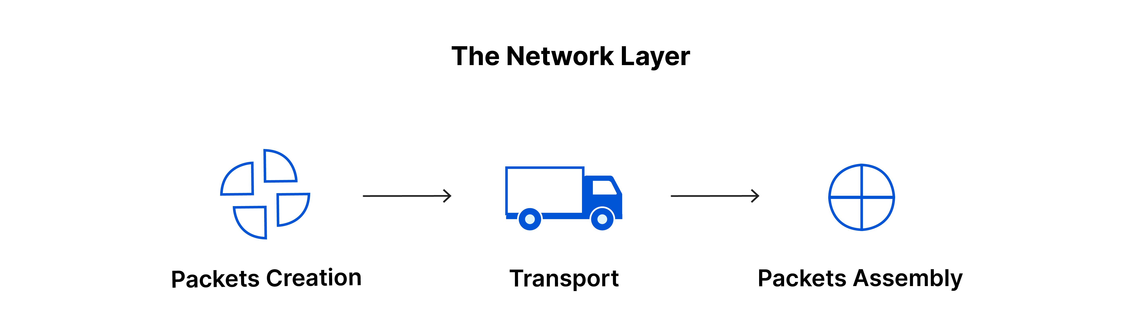
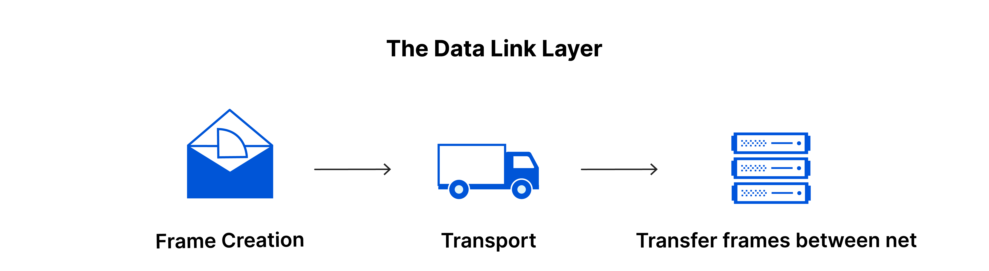
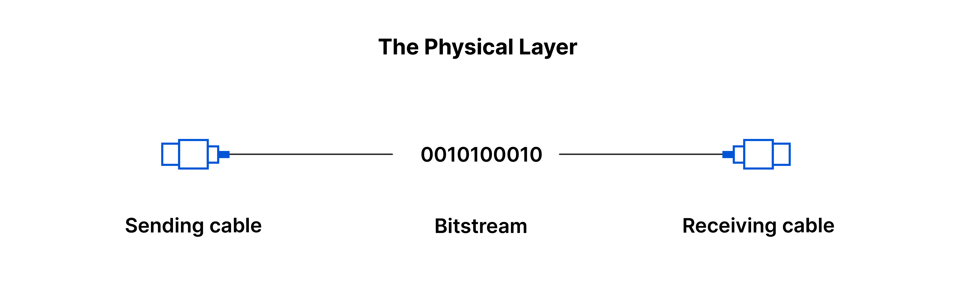
Networking is a Big Stack Of Layered Abstractions
SERVER
(a program running on a computer in a data center somewhere)
CLIENT
(a web browser running in a consumer operating system on a consumer device)
https://www.cloudflare.com/learning/ddos/glossary/open-systems-interconnection-model-osi/
Notes:
There’s a whole enormous stack of technology used to connect the physics of electronic communication to the goal of streaming Severence on Apple TV. Again, there’s are multiple other courses on this.
BUT — sometimes software engineering does involve working in settings where you don’t have all the context, relying on abstractions, standards, and design patterns. It’s hard, but important, to learn how to judge whether you need to learn more, or whether you can ignore the details, or whether you need to find or hire an expert who knows more.
For this class, you basically will basically only ever even think about two of these layers
(click)
the transport layer and the application layer.

Slide 7
The Transport Layer Provides an Abstraction: Sending Messages
SERVER
(a program running on a computer in a data center somewhere)
CLIENT
(a web browser running in a consumer operating system on a consumer device)
Transport Layer
TCP you may have heard of
UDP you don’t need for this class
QUIC is new
Abstraction: sending a message
https://www.cloudflare.com/learning/ddos/glossary/open-systems-interconnection-model-osi/
Notes:
One layer that’s worth mentioning, not because we’ll be using that deeply but because you’re likely to have heard about it before, is the “Transport layer” — if you’ve heard of TCP or UDP, that’s technology that exists at the transport layer. If you haven’t, that’s no big deal.
It’s an oversimplification, but you can think of the transport layer as giving you the ability to send a single message: a single message represents is an arrow drawn from the client to the server, or the server to the client.
Most of you will never have to think about how networks send a single message — in other words, about how the transport layer is implemented and how it relies on other layers — in the same way you’ll never need to understand how chips implement an instruction set architecture.
There are many other

Slide 8
Application Layer Abstraction #1: HTTP
HTTP gathers messages in pairs: client sends, server responds
GET /
ok here you go (status 200, payload <!doctype html><html lang=“en…)
SERVER
(a program running on a computer in a data center somewhere)
CLIENT
(a web browser running in a consumer operating system on a consumer device)
GET /favicon.svg
ok here you go (status 200, payload <svg width="450" height="450" viewBox="…)
POST /api/user/login, payload {"username":"user1","password":”password"}
ok here you go (status 200, payload {"error":"Invalid username or password"})
Notes:
The top level is called the “application” layer, but it’s still a ways away from streaming Plur1bus on Apple TV. (If we’re using the language of networking, there’s not a great analogue for what Netflix or GameNite is — the “application layer” is about supplying an interface to your application.)
HTTP is at the application layer. For the purposes of our discussion, HTTP is about making requests with pairs of transport-layer messages: a request message, and a response message. We’ll use HTTP requests to implement remote procedure calls — that is, functions or procedures that you execute on someone else’s computer (remotely calling the procedure).
GET and POST requests that the simple Express webserver we’ve already seen fit this model exactly: the web server initiates a request, and the server communicates back one time. HTTP is an abstraction where a single application-layer idea — a remote procedure call — is implemented with two transport-layer messages: one from the client to the server, and one from the server to the client.
IDEALLY, DEMO TIME — actually look at these in the network menu: go to google or GameNite (https://gamenite.onrender.com/), open the networking tab, and see how to get a cURL url, and then remove most of the headers (for GameNite, generally only the Content-Type: application/json header is actually important — see next slide for cURL versions of all these requests against the demo GameNite server)

Slide 9
Application Layer Abstraction #1: HTTP
Remember: HTTP requests don’t have to come from a browser!
GET /
ok here you go (status 200, payload <!doctype html><html lang=“en…)
SERVER
(a program running on a computer in a data center somewhere)
CLIENT
(a web browser running in a consumer operating system on a consumer device)
curl 'https://gamenite.onrender.com/'
GET /favicon.svg
ok here you go (status 200, payload <svg width="450" height="450" viewBox="…)
curl 'https://gamenite.onrender.com/favicon.svg'
POST /api/user/login, payload {"username":"user1","password":”password"}
ok here you go (status 200, payload {"error":"Invalid username or password"})
curl 'https://gamenite.onrender.com/api/user/login' \
-H 'content-type: application/json' \
--data '{"username":"user1","password":"password"}'
Notes:
As a reminder from the last lecture — basically any request that the browser makes can be replayed, and possibly tweaked in unexpected ways, with the cURL command line utility. Don’t trust HTTP inputs or any other messages you receive over the network.

Slide 10
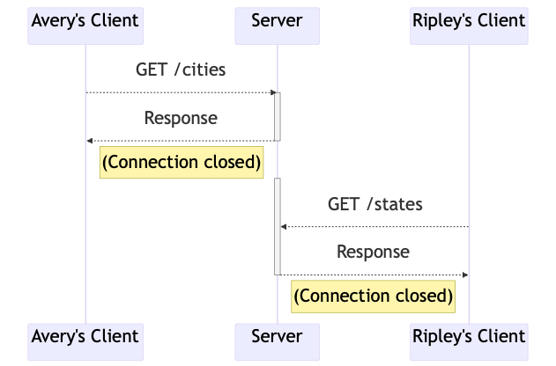
HTTP is Good for ”Function-call-like” Design Patterns
HTTP supports common design patterns:
Remote Procedure Call (RPC): one computer is calling a function on another computer
REpresentational State Transfer (REST): strictly client/server, server doesn’t maintain a session or remember specific clients
A set of routes (like /cities, /states, …) answering HTTP requests is a “REST API”
Notes:
In client-server applications like web apps, it makes sense for a client to treat an HTTP request like a slow function call: the client sends a message to make a function call, and knows it can expect the function call to return with a response message.
This is the “remote procedure call” design pattern: you’re calling a function on another computer. HTTP is just one way of implementing a remote procedure call.
A closely related design pattern is “representational state transfer” or REST. REST is more specific about the fact that there is a client-server interaction at work: function calls always start with clients, and a client shouldn’t assume that the server remembers anything in particular about the previous calls that the client has made to the server. There is a standardized way in which the pattern of a REST is built on top of HTTP.
The GameNite backend supports a bunch of HTTP calls, and it calls this a REST API, even though it’s not quite a REST API. This is… extremely common. The resources contain a link to a good comparison between RPC and REST, and you can read this and see that GameNite incorporates aspects of both. (Too much detail for lecture: What aspects? Well, the GameNite server doesn’t keep track of HTTP sessions with client, very REST. But only supporting JSON is a little outside the expected REST picture, and GameNite’s API design, where every route supports a single GET or POST method — instead of having GET/POST/PATCH/DELETE methods on a single route that represents an abstract “resource” — isn’t really doing REST by the book. Again, this is very common.)

Slide 11
Application Layer Abstraction #2: WebSockets
In a WebSockets session, client or server push messages (no response expected)
I would like to join this chatroom ["chatJoin",{"auth":{"username":"rob",”pass…)
SERVER
(a program running on a computer in a data center somewhere)
CLIENT
(a web browser running in a consumer operating system on a consumer device)
i got u ["chatJoined",{"_id":"68112e17c5df6e25e2c0a2c7","messages":[{"_id":"68136f9ac5df…)
hey someone joined chat ["chatUserJoined",{"user":{"username":”tim”, “display”:”T…)
hey someone joined chat ["chatUserJoined",{"user":{"username":”bo”, “display”:”Ro…)
Notes:
Another important form of client server communication for this class is two-way websocket communication. This differs from remote procedure calls because the server and client set up a persistent connection (the ”socket”) and either player can push a message to the other one. This is what you want for chat.
With HTTP requests, the server sends you a message and you get a single response. With the message passing abstraction websockets, the client still starts a connection, but then the server can send any number of messages back, interspersed with any number of follow-up messages from the client.

Slide 12
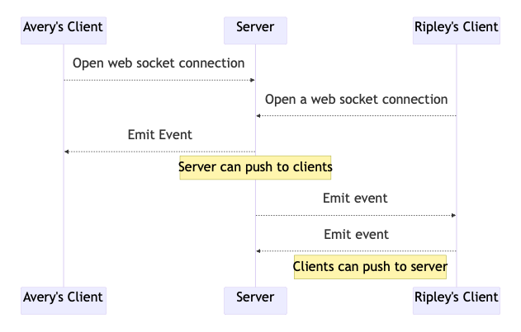
WebSockets is is Good for Event-Driven Design Patterns
A chat message is an “event” that the server wants everyone to know about.
The web server is a centralized point that allows distributed clients to talk to each other.
Centralization is a cheat code for making distributed systems manageable
Notes:
The design pattern for HTTP is a function call. The design pattern for websockets is ”event-driven messaging” — clients aren’t asking for communication, the server is keeping track of clients and notifying them when something happens, like a chat message being sent.
Clients don’t talk directly to each other with web sockets, but they get the illusion of talking directly to each other, facilitated by the server.
.
(Q: How would you implement chat if you only had RPCs? A: polling, probably.)

Slide 13
Application Layer Abstractions: HTTP Endpoints versus WebSockets
HTTP (one-way, client initiates)
Web Sockets (two-way after client opens socket)
Notes:
When you have a bunch of HTTP endpoints that do remote procedure calls, that is collectively called a REST API. (REST stands for Representational State Transfer, which isn’t really helpful to know, just like API stands for Application Programming Interface but that’s not really helpful. A “REST(ful) API” is kind of just the thing people call a usually-HTTP-based-way-of-doing-lots-of-remote-procedure-calls.)
HTTP and WebSockets are the two most important client-server communication technologies, and REST/RPC and message-passing or event-driven-programming are the most important design patterns.
Q: Do you really need both?
(A: if you only have HTTP and you want real-time chat, you have to constant poll the server “hey, did anything happen?” which is generally slower and requires a lot of useless work. You *could* do almost everything with websockets, and that’s how some applications are built… but sometimes you just want to make a function call or get a new webpage, and single-request-single-response is the right model for that. HTTP applications are also, in general, easier to test, and it’s more expensive for the server to always be keeping track of all the connected clients, which is unnecessary if clients are always initiating messages.)
<edit this at: >
https://mermaid.ink/img/pako:eNqFkUFrAjEQhf_KEBBbUASPOQjFlp560R5zSZNZDWQn28xEEPG_N9tYaK20OU1mvnnz4J2USx6VVozvBcnhY7C7bHtDUN9kArZIotK_YW6twWYJLgyWBBxYhocD5uOUYR0DkvyGeIS2mCsGNySW43gThojXIg7m89UKWMPz0yssXJCA3EbWSThYQbj8uaFOwwZ5SMTY-h6vSUq1jtgJpG6UvlsnIqxQInAxMfp7Q7ePVKs_DLHUIX_RzYJb_m_hm5Ecdvs_nKiZ6jH3Nvga0GncM0r22KNRupYeO1uiGGXoXNExqe2RnNKSC85UGXy9eslT6c5Grl30QVJ-aaF_Zn_-AHpDpwY?type=png)](https://mermaid.live/edit#pako:eNqFkUFrAjEQhf_KEBBbUASPOQjFlp560R5zSZNZDWQn28xEEPG_N9tYaK20OU1mvnnz4J2USx6VVozvBcnhY7C7bHtDUN9kArZIotK_YW6twWYJLgyWBBxYhocD5uOUYR0DkvyGeIS2mCsGNySW43gThojXIg7m89UKWMPz0yssXJCA3EbWSThYQbj8uaFOwwZ5SMTY-h6vSUq1jtgJpG6UvlsnIqxQInAxMfp7Q7ePVKs_DLHUIX_RzYJb_m_hm5Ecdvs_nKiZ6jH3Nvga0GncM0r22KNRupYeO1uiGGXoXNExqe2RnNKSC85UGXy9eslT6c5Grl30QVJ-aaF_Zn_-AHpDpwY

Slide 14
HTTP Requests in Express
How implementing an HTTP response looks for an Express server
SERVER
(a program running on a computer in a data center somewhere)
POST /api/user/login, payload {"username":"user1","password":”password"}
ok here you go (status 200, payload {"error":"Invalid username or password"})
CLIENT
import express from 'express’;
let numLogins = 0;
const app = express();
app.use(express.json());
app.post('/api/user/login', (request, response) => {
const { username, password } = request.body;
if (username.toLowerCase() === 'user1' && password === 'sekret') {
response.send({ success: true, numLogins: ++numLogins });
} else {
response.send({ error: 'Invalid username or password' });
}
});
Notes:
We’ve already seen implementations of HTTP request/response pairs in the activity from the previous module.
The design of this Express server works fine if you’ve got one REST-ish endpoint that you want to make, but this quickly becomes spaghetti if you try to extend this into a larger application. Let’s split this up into several parts, creating a design called the Controller-Service-Repository architecture.

Slide 15
Three parts of a web server
The Controller-Service-Repository design separates the server into three parts
The controller knows how we communicate with client, doesn’t know how we store data
The service doesn’t know how we connect to the client or store data, but does as much of the interesting work (“business logic”) as possible without knowing these things
The repository is the only part stores information long-term
Repository
API
Service
API
Controller
internet
Client
browser
User
Notes:
If we take the username/password information and the numLogins information of our simple application and put them in a different application layer, we will end up with a design called Controller-Service-Repository.
Controllers are simple as possible, and by design have no idea how information is stored.

Slide 16
The Controller: Knows about HTTP
// app.ts
import express from 'express';
import * as controller from './controller.ts';
const app = express();
app.use(express.json());
app.post('/api/user/login’, controller.controlLogin);
// controller.ts
import type { Request, Response } from 'express';
let numLogins = 0;
export function controlLogin(request: Request, response: Response) {
const { username, password } = request.body;
if (username.toLowerCase() === 'user1' && password === 'sekret') {
response.send({ success: true, numLogins: ++numLogins });
} else {
response.send({ error: 'Invalid username or password' });
}
};
Notes:
The controller is the first thing we’ll separate out — because a real server will be handling dozens or hundreds of types of requests, we want to split out each kind of request into its own function (bonus: this makes each function more possible to separately test). The top-level app.ts file is doing the absolute minimum amount of work, just setting up the application (for instance, saying it only responds to JSON requests) and routing different URLs to different controller functions.
The controller still knows about the fact that it’s implementing HTTP requests in an express server — the request and response types are coming from the Express library.
Once we’ve implemented the controller layer, we don’t have to think about URL routing much anymore, so let’s focus on the controller.
While we’re at it, on the next slide we’ll add back Zod validation so that we can properly check that the request body is what we expect it to be.

Slide 17
The Controller (with Zod Validation)
// controller.ts
import type { Request, Response } from 'express';
import { z } from 'zod';
let numLogins = 0;
const zLoginReq = z.object({ username: z.string(), password: z.string() });
export function loginController(request: Request, response: Response) {
const auth = zLoginReq.safeParse(request.body);
if (!auth.success) {
response.send({ error: 'Bad request' });
} else if (auth.data.username.toLowerCase() === 'user1' && auth.data.password === 'secret') {
numLogins += 1;
response.send({ success: true, numLogins });
} else {
response.send({ error: 'Invalid username or password' });
}
};
// controller.ts
import type { Request, Response } from 'express';
import { z } from 'zod';
let numLogins = 0;
const zLoginReq = z.object({ username: z.string(), password: z.string() });
export function loginController(request: Request, response: Response) {
const auth = zLoginReq.safeParse(request.body);
if (!auth.success) {
response.send({ error: 'Bad request' });
} else if (auth.data.username.toLowerCase() === 'user1' && auth.data.password === 'secret') {
numLogins += 1;
response.send({ success: true, numLogins });
} else {
response.send({ error: 'Invalid username or password' });
}
};
Notes:
Let's look at the controller in a little more detail. Here we've added validation with Zod, just like we recommended in M3.1.
(click to remove highlight)
This controller is still doing too much. That’s not a big problem here, because we’re doing almost nothing interesting. But if this controller was providing access to something more complicated, like the transcript server we’ve discussed previously, this can get very spaghetti-code, very fast.
The rule of thumb is that we want to implement a different layer, the service layer, that does as much as possible of the interesting work — ”business logic” is a boring term that means “everything interesting your application does”. Controllers should validate inputs and decide what kind of response to give (which usually means they handle access control and permissions). They should do as little else as possible.
(code examples: https://github.com/neu-se/tiny-csr)

Slide 18
The Controller Relies on the Service Layer
// controller.ts
import type { Request, Response } from 'express';
import { z } from 'zod';
import { isAuthorized, incrementLogins } from './service.ts';
const zLoginReq = z.object({ username: z.string(), password: z.string() });
export function controlLogin(request: Request, response: Response) {
const auth = zLoginReq.safeParse(request.body);
if (!auth.success) {
response.send({ error: 'Bad request' });
} else if (isAuthorized(auth.data.username, auth.username.password)) {
const numLogins = incrementLogins();
response.send({ success: true, numLogins });
} else {
response.send({ error: 'Invalid username or password' });
}
};
The controller should validate inputs
The controller uses the service layer to construct an appropriate response
Notes:
In our example, the only examples of business logic were checking the password, updating the number of successful logins, and returning the new number of successful logins. This business logic can be represented into two service layer functions.
With this change, the controller is now doing as little as possible: it’s validating inputs, deciding which kind of response to give, but not much else.
It’s hopefully apparent how this business logic could get a lot more complicated — for instance, checking isAuthorized against a list of hundreds of usernames, or against a database where usernames and passwords are stored — while the controller could remain relatively simple.
(code examples: https://github.com/neu-se/tiny-csr)

Slide 19
The Service Layer Has Most of the Business Logic
// service.ts
export function isAuthorized(username: string, password: string) {
return username.toLowerCase() === 'user1' && password === 'secret'
}
let numLogins = 0;
export function incrementLogins() {
const oldNumLogins = numLogins;
numLogins += 1;
return oldNumLogins;
}
What user needs aren’t being met here (and in the IP1 starter code?)
How can we do better?
(Change password? Save numLogins when rebooting?)
(Add a database)
Notes:
Rounding out the example, here’s the (incredibly simple) business logic separated out into a service layer. A more realistic example of a service layer, but one that’s still incredibly simple as web applications go, is the transcript service, which is a service layer interface.
While incredibly simplified, this controller-service architecture pretty much represents the way your IP1 starter code is set up. If you’ve been working with IP1, you’ve also probably noticed that the starter code for IP1 would be a horrible implementation of a service like GameNite. What’s the biggest problem shared by this demo application and by the IP1 starter code?
(I’m curious if students have other answers here! But hopefully they will get to: the gamenite server resets every time it reboots, and here, there’s one unchangeable username/password and the number of logins evaporates if you restart the server program.)
(code examples: https://github.com/neu-se/tiny-csr)

Slide 20
The Repository Layer Provides Persistence
Logins should be cumulative even if we restart the server
Adding users and changing passwords shouldn’t necessarily require updating code
Lots of ways to achieve this:
MongoDB
PostgreSQL
SQLite
A file on the hard drive

Slide 21
Foreshadowing
Adding a persistent repository makes one big difference!
almost every action that reads or writes data is now hundreds of times slower, and involves reading to disk
this involves a relatively long delay, during which the CPU isn’t doing anything useful
JavaScript handles this with asynchronous programming; that’s a topic we’ll return to in a few weeks.

Slide 22
Review: three parts of a web server
The repository is the only part that stores information long-term
This is pretty much a synonym for “database”
The service doesn’t know how we connect to the client
HTTP? REST? WebSockets? The service shouldn’t know!
Business logic lives here
The controller doesn’t know how we store data
Blissfully unaware of whether we’re using a database or just memory (like in IP1)
Repository
API
Service
API
Controller
internet
Client
browser
User
Notes:
If we take the username/password information and the numLogins information of our simple application and put them in a different application layer, we will end up with a design called Controller-Service-Repository.
Controllers are simple as possible, and by design have no idea how information is stored.

Slide 23
Review: three parts of a web server
Everything we saw from the transcript server is the business logic — a boring-sounding name that refers to most of the interesting stuff a web server does
“Is this HTTP request coming from a recognized user?” — not business logic
“Does this user have permission to access student records” — business logic!
“Do new grades go at the front or back of the list” — business logic!
Notes:
We intentionally want to keep the controller and repository as simple as possible — the business logic should be where the action is!
Connections:
in module 2 we talked about testing for a service layer abstraction. The service layer abstraction didn’t include checks for permission; that’s handled at the controller level
in module 3 and earlier in this lecture we saw how Express implements a the controller part of the abstraction
IP1 has a service and controller layer… but no real repository, it’s just using hashtables in memory to store all its data
IP2 and beyond will have all three layers: controller, service, and repository

Slide 24
Testing Controller-Service-Repository Servers
Testing at the service layer tests the service+repository, testing by invoking API calls tests controller+repository+server
You can also test the controller level in isolation
What are the pros and cons of each?
Sometimes we’ll want to test the service layer and/or controller layer without the repository layer!
We’ll come back to this.
Notes:
(The pros of testing at the service layer are the pros of more-unit-y testing, more or less: you’re testing smaller and more independent units, and you may be able to test parts of your code that are intentionally not exposed through the REST API. Testing at the controller layer serves as documentation of how you expect your client application to actually communicate with your server.)
(Note: you need mocking to test the service layer without the repository layer, which hasn’t been covered yet)

Slide 25
Web Applications: One Server, Many Clients
We’ve mostly ignored so far that one server is supposed to connect to many clients
This isn’t always apparent when everything’s running on your laptop
Each web page with GameNite open is a different client
Server
Client
Client
Client
Client
Client
Notes:
When you start writing your own web apps (like IP1 & IP2), the Server and the Client are both running on your laptop. That sometimes makes it difficult to remember that these are supposed to be two different machines.
The fact that both the code the Server machine and the code for the Client machine reside in a single repo further muddies the waters. Q: Is there anything that is accidently shared in the repo that won’t be shared if the Server and Client were running on two different physical machines? (A: Generally not, because the client code is running in a browser sandbox. However, sometimes in the kind of repo setup we’re using, secrets — like database access keys — that are supposed to only live on the server can accidentally get bundled and set to the client.)
TRANSITION: What happens when there are too many clients?

Slide 26
Scaling The C-S-R Architecture
Web services often start on a single computer
When that gets too slow, the repository is easy to put on a different computer
Repo
Controller / Service
Client
Client
Client
Client
Client

Slide 27
Horizontal Scaling
By separating out the repository layer, the service layer becomes stateless: all the state it uses lives in the repo.
Multiple copies of the controller can connect to multiple clients!
AWS will be delighted to help, only real limit is money
Repo
Controller / Service
Controller / Service
Controller / Service
Client
Client
Client
Client
Client
Notes:
Key idea: horizontal scaling is facilitated by the C-S-R architecture, is comparatively easy to deal with, and scales quite far in practice.
“Horizontal” is literally referring to something like this picture: we’re making more copies of the thing to the left and right.

Slide 28
State and statelessness
A web server or web service should be stateless
Every REST request should be indifferent to whether the node application has been running for several hours or five seconds
Also indifferent to whether other copies are communicating with different clients, as long as they’re communicating with the same Repository
Our silly application, and the IP1 code, is not stateless (why?)
If the web server is going to be stateless, and the web application has state, the server has to phone a friend (the Repository layer) to:
Access the filesystem
Query a database
In C-S-R, the repository layer/database is the point of centralization
Centralization (& hierarchical centralization) is a cheat code for making distributed systems manageable
Notes:
Rob: it was very confusing to me when I first read about stateless web applications, because people only talk about “stateless” web applications when those applications care a lot about state!
The thing I was missing was that “stateless” means that you have service layers that don’t manage their own state, they spin that job off to a repository layer.

Slide 29
Vertical Scaling
Big, Big Database
Centralized databases tend towards vertical scaling: move your database to a more powerful computer
This has limits: the database will eventually become a bottleneck
What to do?
Controller / Service
Controller / Service
Controller / Service
Client
Client
Client
Client
Client
Notes:
Key idea: vertical scaling will only get you so far, computers stop getting bigger at some point. Vertical is also being illustrated in this picture: you’re vertically scaling by making individual computers bigger and able to handle more.
Most of the time, limitations on vertical scaling are when you need to start talking to people who have thought a long time about distributed systems, and for most systems this is a very painful transition.
However, ”what to do at this point” is also the kind of problem you might get in an interview, so it’s worth talking a little bit about! What might we do?
(If nobody points out “we need more information to decide,” point out that knowing when you need to get more information to decide is important for software engineering writ large — requirements gathering, remember! — and for interview questions specifically. The next two slides describe two routes you might take depending on why the database bottleneck is occurring.)

Slide 30
Scaling Past the Database Bottleneck (1)
Maybe the problem is that you’re occasionally doing big, expensive analysis on your database, like analyzing your sales data
Database read-only-replicas are an easy solution here — seconds to minutes behind reality (and can add reliability in case of failure!)

Slide 31
Scaling Past the Database Bottleneck (2)
Maybe you can identify parts of your data that are independent, and don’t need to be synchronized or stored together
Chat and game information in GameNite could live in separate places
Games could have their business logic running on different servers, written in different programming languages, and accessed (by the server the client is connected to) through their own REST API!
This can help with need-more-CPU bottlenecks as well as need-a-beefier-database bottlenecks.
This way lies microservices

Slide 32
Microservices
Different languages, different operating systems
NodeJS, MongoDB
Google Service
Java, MySQL
Todos
Logins
Mailer
Mod 1
Mod 2
Mod 3
REST service
REST service
REST service
Productivity App
Database
Database
Database
Frontend
REST
Search Engine
Analytics
Social Crawler
“Dumb”
App Server
Mod 4
Mod 5
Mod 6
REST service
REST service
REST service
Database
Database
Database
Java, Neo4J
C#, SQLServer
Python, MongoDB
Notes:
Here is an example of a micro services architecture for a productivity application. There are multiple components to this application. Each component is shown as a grey box, and is a micro service.
(Note the separation of responsibilities to entirely different services that only connect over a well-defined API)
(Discussion: what could go wrong? Complex APIs? Hidden dependencies (what if you change the behavior behind one of these APIs? (Remember what we said about "contracts" back in the testing lecture) Operations that involve multiple databases, but still need to appear atomic (eg in a bank)?)

Slide 33
Microservices
Netflix is the microservices darling
100s of microservices
1000s of daily production changes
10,000s of instances
BUT:
only 10s of operations engineers
https://medium.com/refraction-tech-everything/how-netflix-works-the-hugely-simplified-complex-stuff-that-happens-every-time-you-hit-play-3a40c9be254b
Notes:
Remember: we’re teaching a version of distributed systems that works for medium-to-large web applications, and this is all bad advice if you’re Netflix or Google. Netflix takes the microservice architecture to the extreme.
But when we say “medium-to-large web applications” that can be pretty large — you’d probably be surprised how many websites you’re interacting with have a single database as a source of centralization.

Slide 34
Microservices
The opposite of “microservices” is “monolith”
higher is better
https://martinfowler.com/microservices/
Notes:
Microservice advocates claim that as the system grows in complexity, the micro service abstraction provides gains in understanding and productivity that outweigh the cost of the added complexity.
It would be interesting to have some hard data about this, but companies probably don’t want to be too transparent about stuff like this.

Slide 35
GameNite is Monolithic
GameNite is a monolithic application
It’s not perfect: there’s probably a bit too much business logic in the controller layer (service layer doesn’t quite do enough)
You’ll start IP2 with a more proper web app
MongoDB is the database used for repository layer, by way of a general-purpose adapter called Keyv
Changing the repository greatly changes the service layer
The controller doesn’t change much (the controller is mostly unaware of the repository later)

Slide 36
Review
At the end of this lesson, you should be able to
Explain the role of “client” and “server” in the context of web application programming
Explain the role of HTTP endpoints and REST APIs versus WebSocket communication and event-driven messaging in a web application
Describe the fundamental differences between the three layers of the controller, service, and repository layers in a C-S-R architecture
Understand how the C-S-R architecture works in the context of a basic Express application
Be able to answer an interview question about “business logic,” “horizontal and vertical scaling,” or “microservices”

